Slide 1

Microsoft Virtual Academy
Free, online, technical courses
Take a free online course.
http://www.microsoftvirtualacademy.com

Slide 2
Open Source for DevOps Practices
Ross Gardler
David Tesar

Slide 3
We will cover…
DevOps Overview
Azure Basics + Process Tools
Source Code Repos + Communication
Reproducible Environments
Automated Testing
Deployment & Configuration Management
Release Management
Monitor + Learn

Slide 4
Automated Unit Testing

Slide 5



Automated Testing
Testing Software
Value
Availability
Quality
X
Measure
MTBF
DEV
OPS

Slide 6


Manual Builds
Test
Deploy
Environments
Monitor and Learn
DEV
OPS
Build
Client Workstations
Source
OR
Team Foundation Server
TFVC
GIT

Slide 7
Continuous Integration
Test
Deploy
Environments
Monitor and Learn
DEV
OPS
Build
Client Workstations
Source
OR
Team Foundation Server
TFVC
GIT

Slide 8







Automated Testing OSS Tools
Test
Deploy
Environments
Monitor and Learn
Production/Stage
Hudson
Develop
Build
Developer Workstations
Jenkins
Source
GitHub
Codeplex
Grunt
Gradle
Dev/Test
Processes

Slide 9
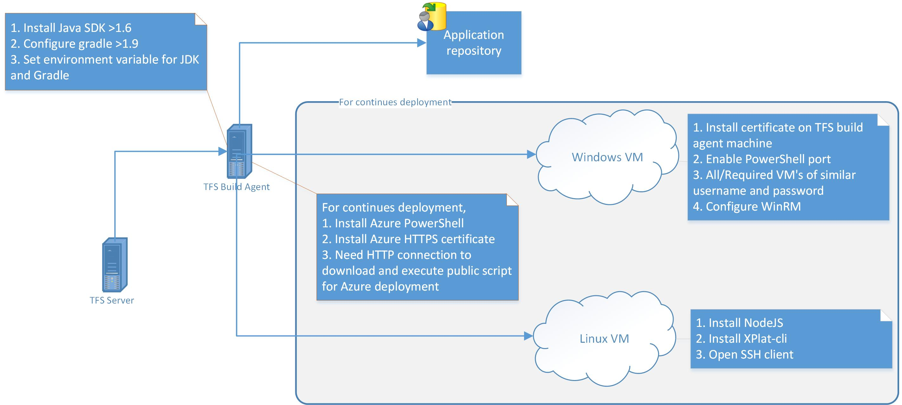
What is Gradle?

Slide 10
Why Gradle?
Why
Powered by a rich extensible DSL based on Groovy, Gradle provides a declarative way to describe all kinds of builds.
How
It is possible to use Gradle alongside TFS This allows TFS users to leverage Gradle as a build tool, as well as to use Gradle to enable continuous deployment of Microsoft Azure cloud services for both Linux and Windows.
http://msopentech.com/opentech-projects/gradle/

Slide 11
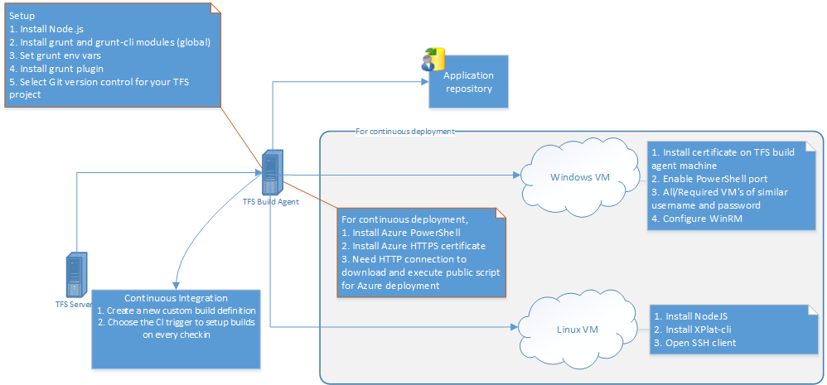
What is Grunt?
See http://msopentech.com/opentech-projects/grunt/

Slide 12
Why Grunt?
Why
Less work to do when performing repetitive tasks like minification, compilation, unit testing, linting, etc.
How
Open source code from MS Open Tech now makes it possible to automate JavaScript build and test jobs on TFS
See http://msopentech.com/opentech-projects/grunt/

Slide 13
Using Grunt to Automate common task

Slide 14
Recap
Grunt and Gradle can help with
Continuous Integration
Automated Testing
Integrates with TFS
Where we are at?
Still no continuous deployment or release pipeline

Slide 15
Deployment
&
Configuration Management

Slide 16

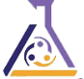

OSS Deployment & Config Mgmt Tools
Test
Deploy
Environments
Monitor and Learn
Microsoft Azure
ONE CONSISTENT PLATFORM
ON-PREMISES
SERVICE PROVIDER
Production/Stage
Chef
Puppet Labs
Develop
Build
Developer Workstations
Saltstack
Source
GitHub
Codeplex
Dev/Test
Processes

Slide 17

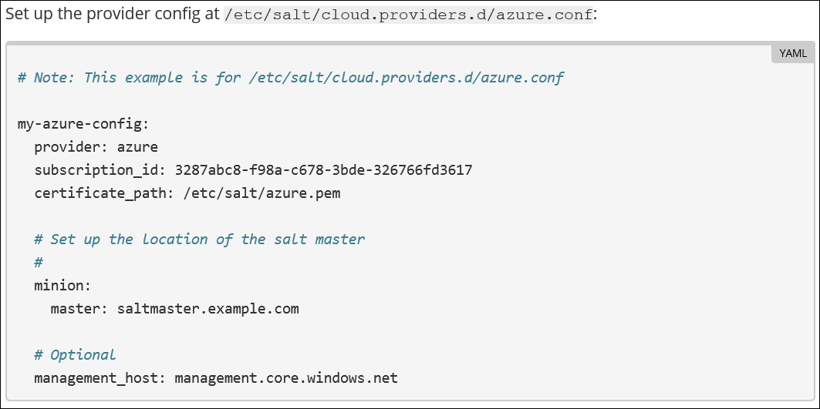
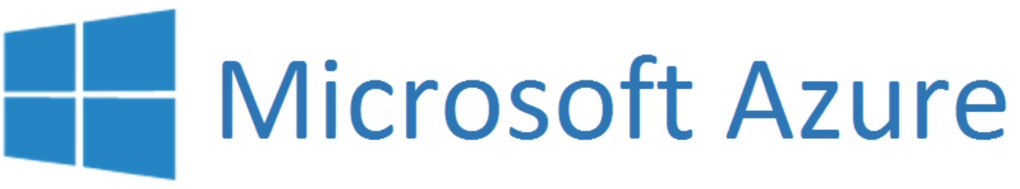
What is Salt?
Master
Client

Slide 18
Why Salt?
Why
A dynamic communication bus for infrastructures for orchestration, remote execution, configuration management and other tasks.
A distributed remote execution system that can execute commands and query data on remote nodes, either individually or by arbitrary selection criteria
How
With the Salt Azure module, developers can deploy, inspect and destroy virtual machines, and then employ the full power of Salt to manage an Azure infrastructure and virtual machine configuration.
http://msopentech.com/opentech-projects/salt/

Slide 19

Virtual Machine management

Slide 20
Virtual Machine management

Slide 21
Why Puppet?
Why
Infrastructure as a code automate repetitive tasks for thousands of servers
Desired state guarantee compliance
How
Azure Puppet Module enables Puppet to provisioning Azure resources:
Virtual Machines – both Linux and Windows
Virtual Networks – create logically sections and securely connect them to your on premise
SQL Server – create and maintain your database
Storage accounts – create and manage
Cloud services - for application management
Disk and Role management - for virtual machines
http://msopentech.com/opentech-projects/puppet/

Slide 22
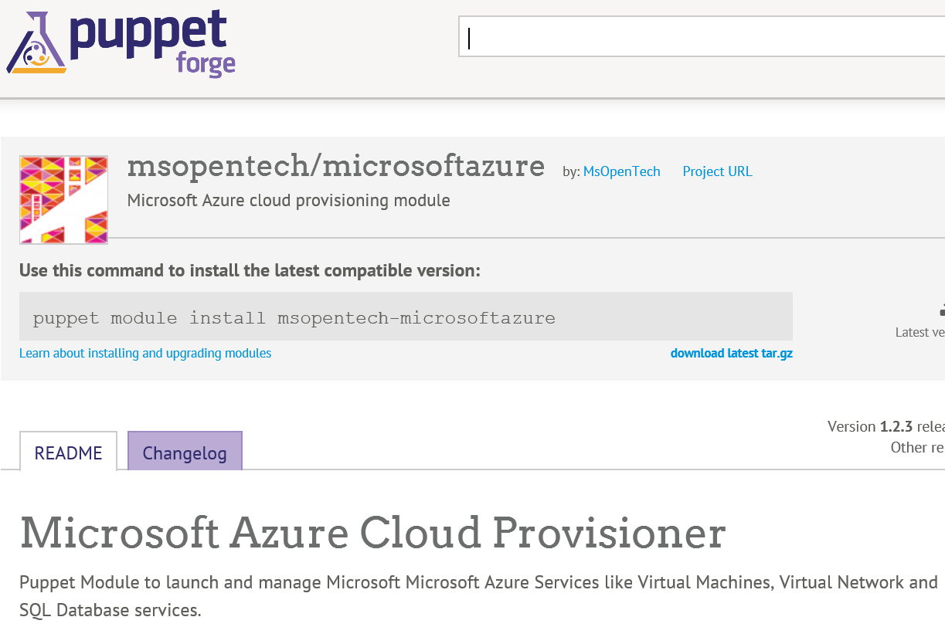

Slide 23

How Chef Works
Test
Deploy
Environments
Monitor and Learn
VM
Chef Master
Develop
Build
Developer Workstations
Puppet Labs
Source
Processes

Slide 24
Why Chef?
Why
Maintain consistency in your infrastructure by modelling its true state
Reduce downtime by monitoring for exceptions and unplanned events and reconstructing your entire network (or any portion of it) if needed
How
Chef supports Azure VMs, allowing automatic creation and configuration of virtual machines and their resources

Slide 25
chef-apply on Azure

Slide 26
Configuration Management and Docker Together?
Docker containers are great for Ephemeral infrastructure
Cheap to rebuild and redeploy the container
Don't really care about state management
Focus on managing the current build
Config. management focusses on enduring infrastructure
Care about the machine over a long period of time
Must be kept in a known state automatically
Prevent drift

Slide 27
Docker + Configuration Management
(Recommended) Configuration Management
Configuration Management for the (Virtual) hardware
Ensures virtual machines are configured correctly
E.g. Manage networks, on machine configuration files, logging etc.
Docker manages containerized applications on that infrastructure
(Optional) Build Management
Create complex images
without complex Dockerfiles
Only one tool to learn
Provides portability between Containers and VMs

Slide 28
Recap
Numerous ways to deploy and ensure consistent configuration
Where are we at?
Pushing new updates to applications?
Monitoring those applications for issues?

Slide 29


TechNet Virtual Labs
Deep technical content and free product evaluations
Hands-on deep technical labs
Free, online, technical courses
At the TechNet Evaluation Center you can download free, trial versions of Microsoft software, with no feature limits. Dozens of trials are available – all at no cost.
Try Windows Server 2012 for up to 180 days. Download the Windows 8 Enterprise 90-day evaluation. Or try Microsoft Azure at no-cost for up to 90 days.
Microsoft Hands On Labs offer virtual environments that will take you through guided, technically deep product learning experience.
Learn at your own pace in labs that you can complete in 90 minutes or less. There is no complex setup or installation is required to use TechNet Virtual Labs.
Microsoft Virtual Academy provides free online training on the IT scenarios that are important to your company and your career.
Learn at your own pace and boost your IT skills with over 100 courses across more than 15 Microsoft technologies including Windows Server, Windows 8, Microsoft Azure, Office 365, virtualization, Windows Phone, and more.
Download Microsoft software trials today.
Find Hand On Labs.
Take a free online course.
Technet.microsoft.com/evalcenter
Technet.microsoft.com/virtuallabs
microsoftvirtualacademy.com

Slide 30

© 2012 Microsoft Corporation. All rights reserved. Microsoft, Windows, Windows Vista and other product names are or may be registered trademarks and/or trademarks in the U.S. and/or other countries.
The information herein is for informational purposes only and represents the current view of Microsoft Corporation as of the date of this presentation. Because Microsoft must respond to changing market conditions, it should not be interpreted to be a commitment on the part of Microsoft, and Microsoft cannot guarantee the accuracy of any information provided after the date of this presentation. MICROSOFT MAKES NO WARRANTIES, EXPRESS, IMPLIED OR STATUTORY, AS TO THE INFORMATION IN THIS PRESENTATION.

